Slide 1
These are the slides I made while recording the “making the fly camera” video in 2024, I think.
i.e. they won’t make a ton of sense unless you are seeing that video.
The TLDR is that we are “pointing” an imaginary location just in front of the camera, rotating it relative to the camera just like we’d rotate any other object in 3D space (with the matrix functions), then when we “move” the camera, we move “towards” this imaginary location.

Slide 2
At: 0,1,0
Eye: 0,0,0

Slide 3
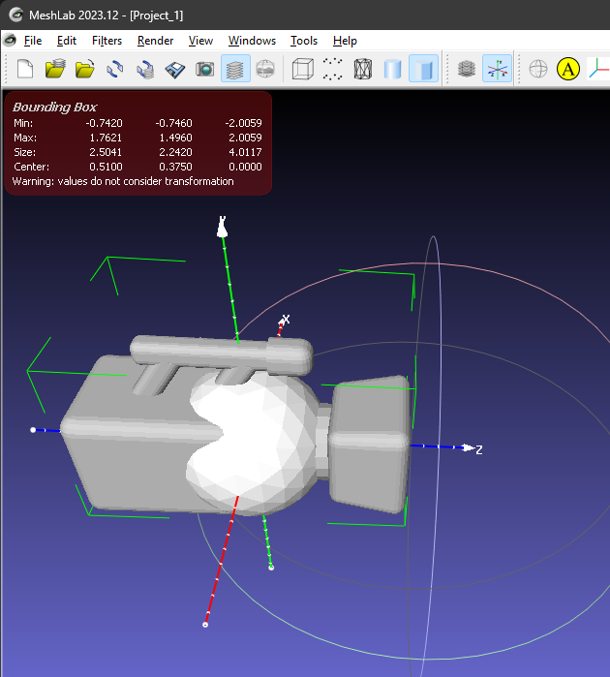
The “front” of the camera lens is about 2.0f units from the “camera origin”
This sphere is really big (will block the view of the camera).
I’ll make it smaller.
Move it “in front” of the camera”

Slide 4
How to move or rotate the camera?
Translation (aka “move”) we can just add to the position
Or we could use a matrix
How about rotation?
We could look up all the trig stuff… (which is fine, by the way)
OR
Use the rotation matrix stuff we’ve already used to place models, etc.
We’ve been using a 4x4 matrix, but that’s because we need scale and translation in addition to rotation…
…but the actual 3D rotation matrix is only 3x3:
https://en.wikipedia.org/wiki/Rotation_matrix

Slide 5
How to move or rotate the camera?
glm already has the rotation matrix stuff for 4x4 and 3x3
We do the same math transformation we did with the DrawObject, where we are calculating some rotation/orientation change, then applying to a matrix, which is being applied to the “front” of the camera (the front of the lens, where it’s always looking), and this forces the camera (target/at) to point in that direction.
To “move” we change the position of the camera based on this transformed “front” location

